Slide 1

How to trade cryptocurrencies on the Binary.com MT5 platform
Notes:
Hi, everyone! This video is going to show you how to trade on MT5. It’s very simple so let’s get started.
First, go to mt.binary.com and log in.

Slide 2
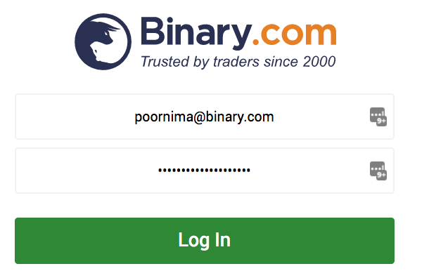

1
Log in to https://mt.binary.com
client

Slide 3
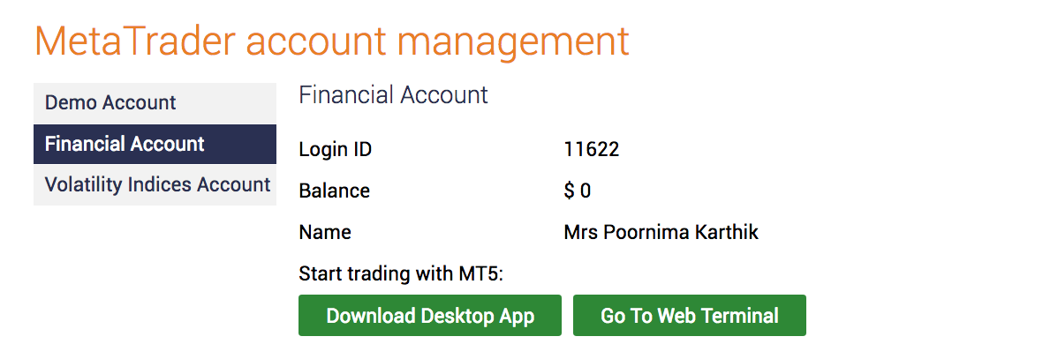

2
Select Financial Account and go to your Web Terminal
Binary.com Client

Slide 4
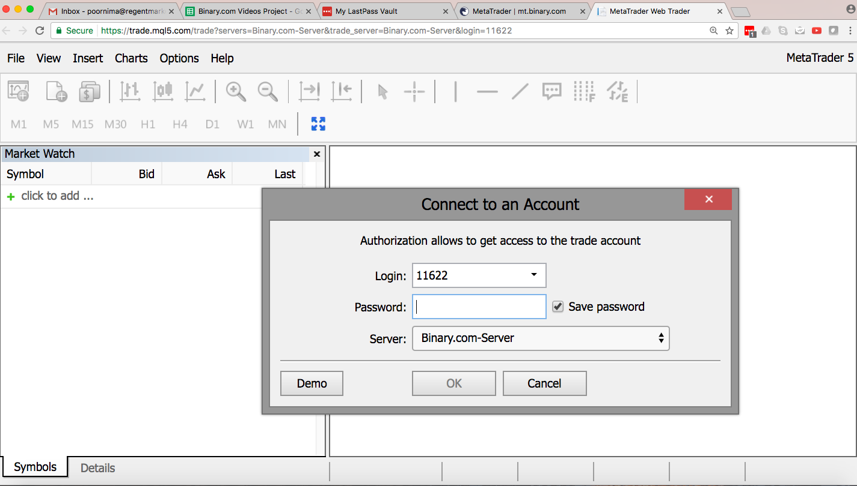
3
Next, log in to your MT5 Financial Account
Enter your MT5 Financial account trading password

Slide 5
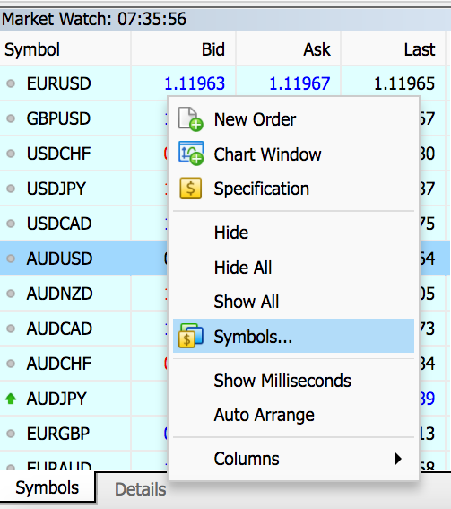
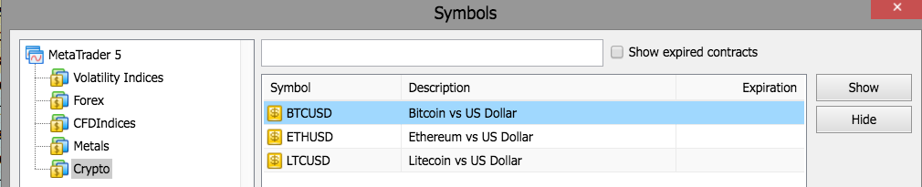
4
Add cryptocurrencies to your Market Watch
2. Select Crypto from the list
3. Select each symbol, and click ‘show’ to add the symbol to your Market watch
1. Right-click the Market Watch window and select ‘Symbols’

Slide 6
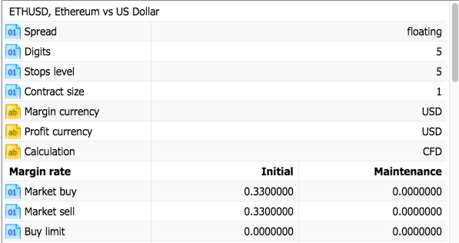
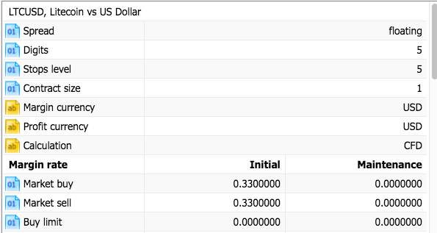
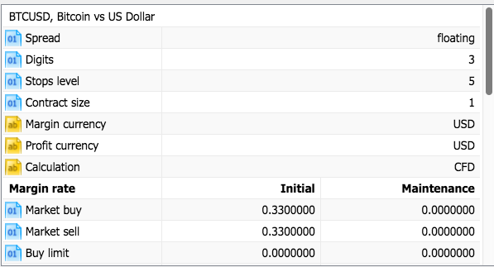
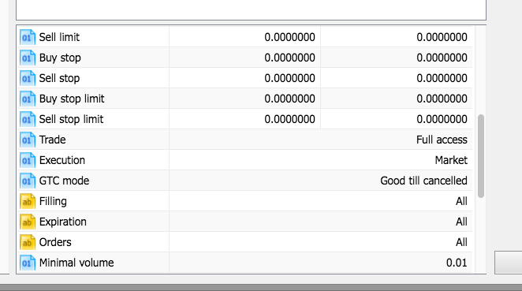
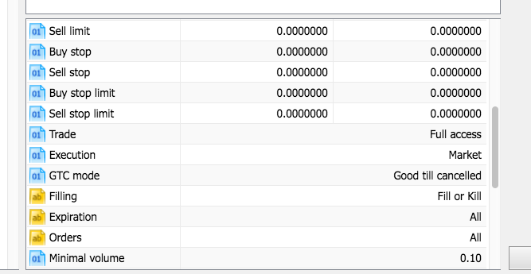
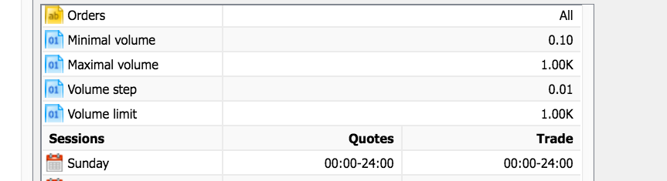
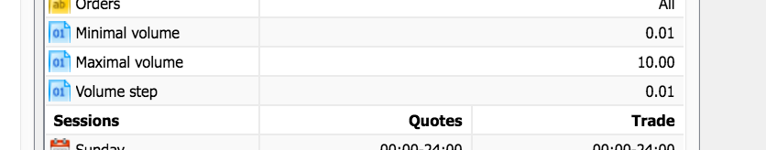
5
Select any symbol to view the margin rate
Here’s how you can check the margin rate for ETH/LTC/BTC

Slide 7
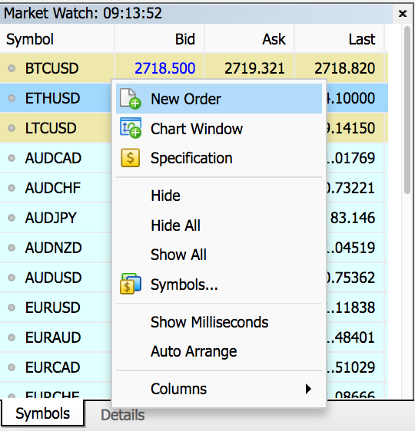
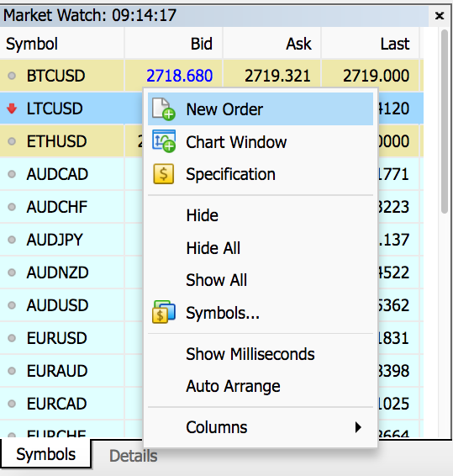
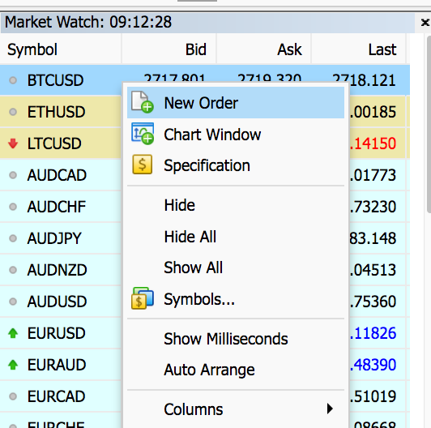
6
How to open a new position.
Step 1: Right-click (ETHUSD/LTCUSD/BTCUSD) and select ‘New Order’ or simply double-click on the symbol to open the ‘New Order’ window

Slide 8
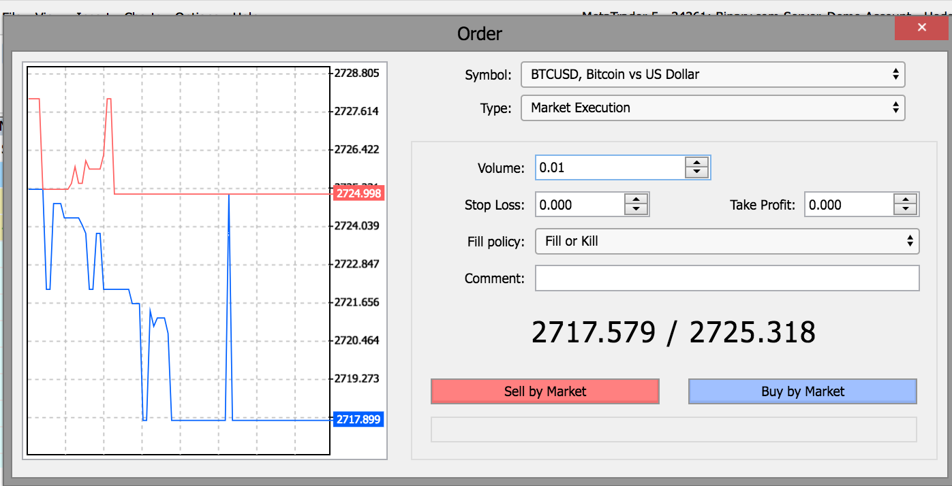
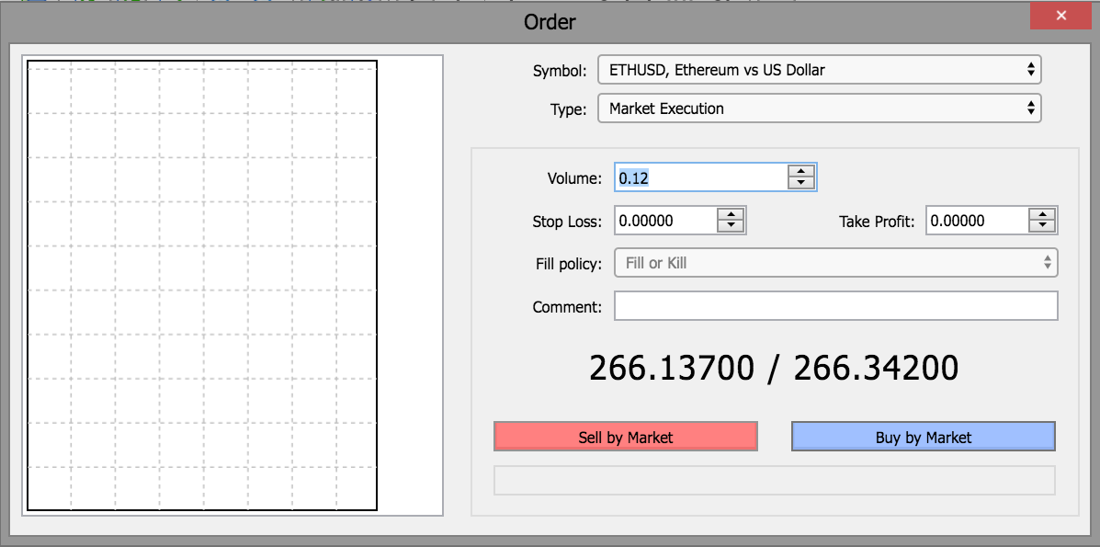
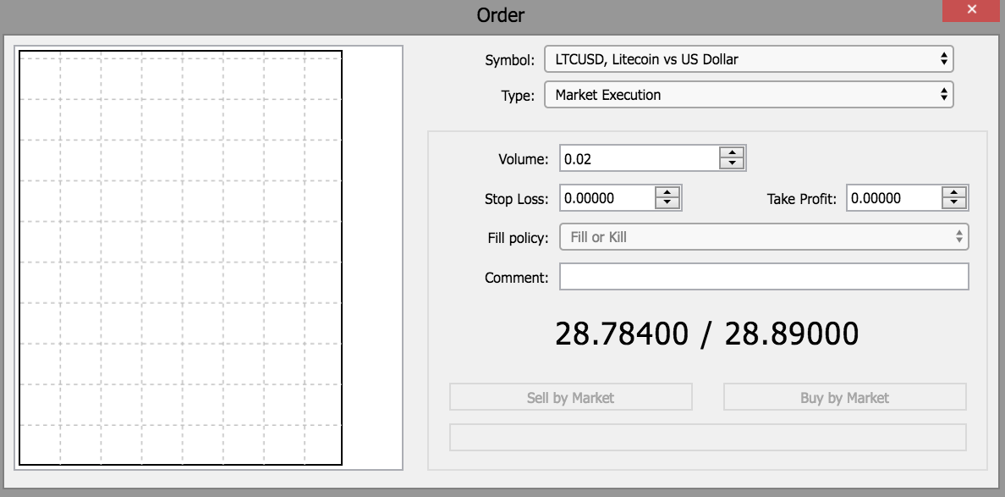
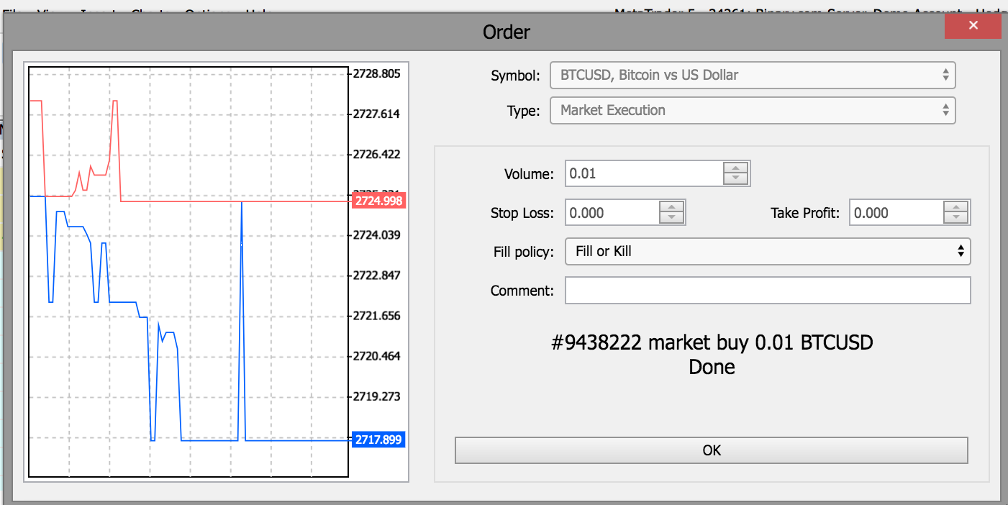
6
How to open a new position
Step 2:
Adjust the limits of your contract and select ‘Buy by Market’
Note: You can also choose ‘Sell by Market’ to ‘short sell’
Step 3:
Click OK to confirm the order

Slide 9
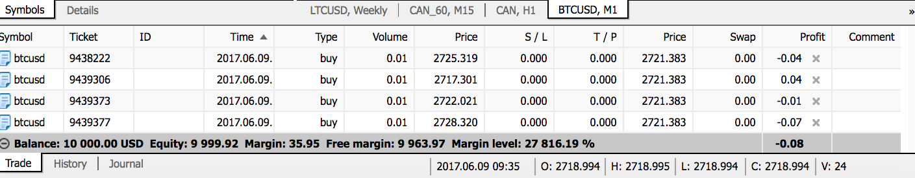
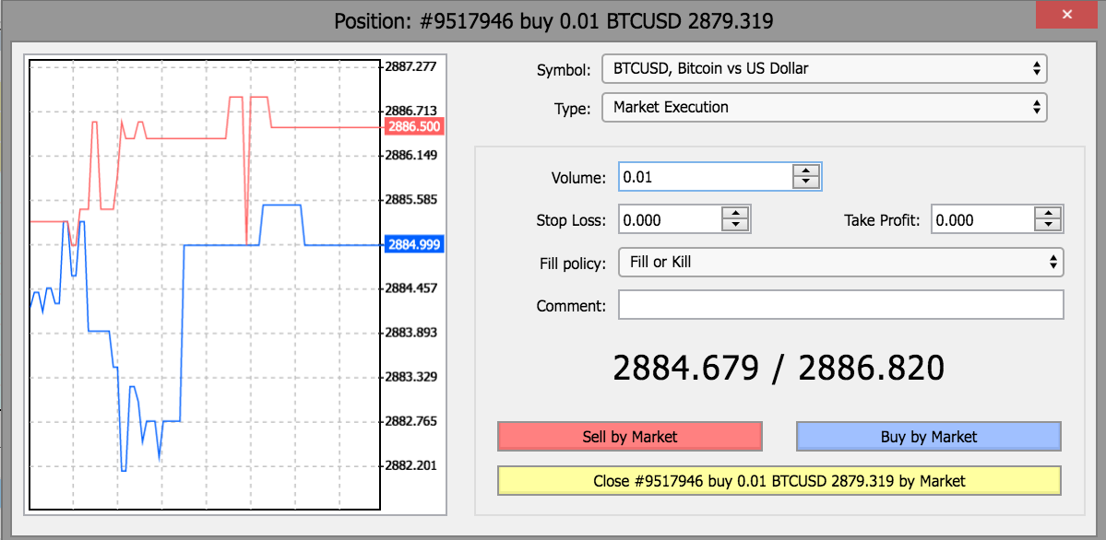
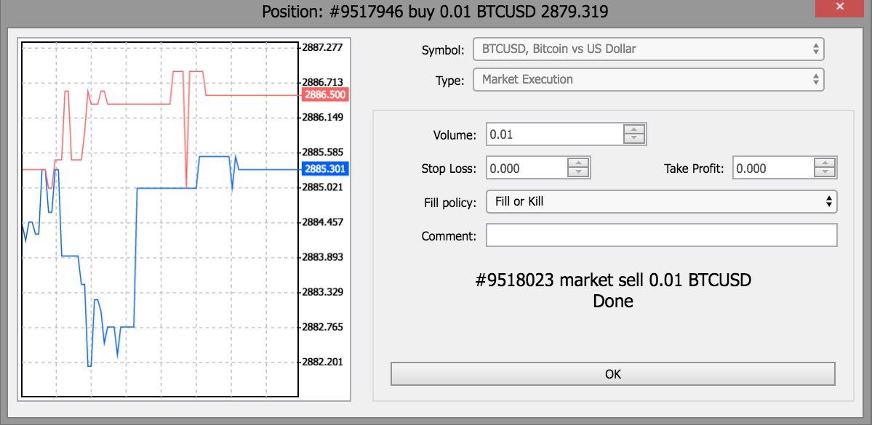
7
Here’s how you Close your position
Step 1: Double-click on the open position in the Terminal window to modify or delete the order.
ltcusd
ethusd
Step 2: Click ‘Sell by Market’.
Step 3: Click OK to confirm.

Slide 10
8
How to check your History
Step 1: Click on the History tab to view the profit/loss for a contract
Step 2: Select a particular contract and refer to the ‘Profit’ column to see its profit/loss

Slide 11



Register now
For inquiries, email marketing@binary.com
support@binary.com
1-803-410-5935
Notes:
If you have any questions or you would like to know more about the MT5 platform, feel free to drop us an email at marketing@binary.com.
Thank you for watching!

